Slide 1
Unit testing
UI
MSLogic
History
Storage

Slide 2
Unit testing
Test Driver
MSLogic
History Stub
StorageStub

Slide 3
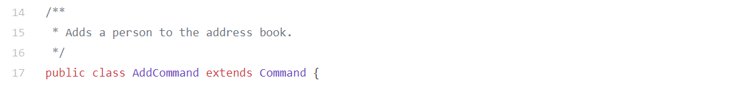
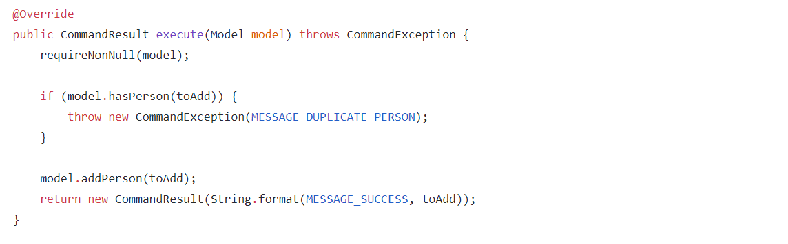
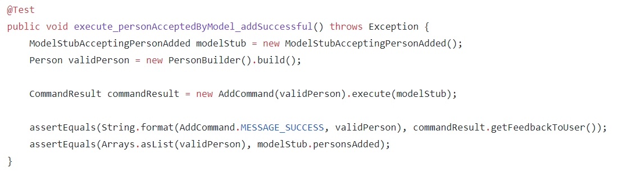
Dependency injection
AddCommand
<<interface>> Model
ModelStub…
:AddCommandTest
:AddCommand
:ModelStub…

Slide 4
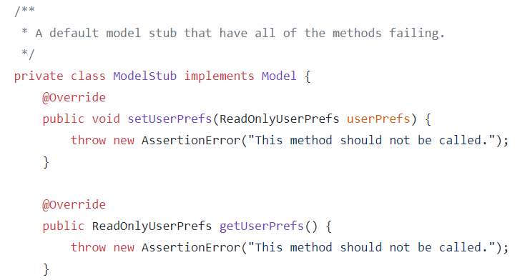
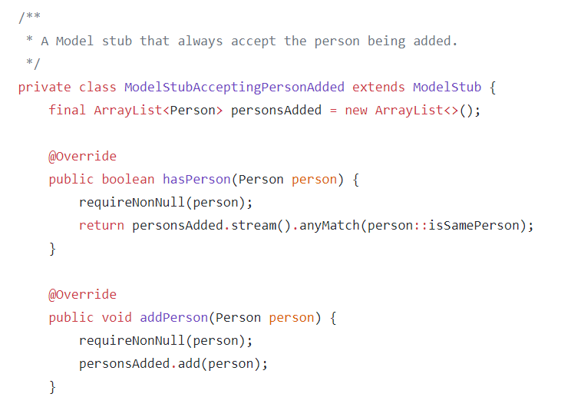
Dependency injection
<<interface>> Model
ModelStub
ModelStubAccepting PersonAdded
Stub:
Same implementation as the concrete object
No functionality or minimal implementation

Slide 5
Dependency injection…
Helps to isolate SUT from its dependencies
Can increase the number of classes in the code base
Can be done using interfaces and/or inheritance

Slide 6
UI
MSLogic
History
Storage

Slide 7
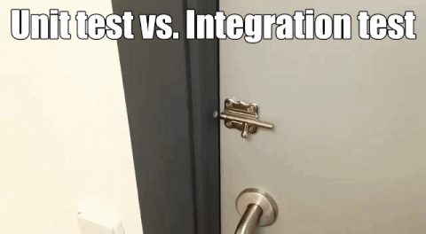

Slide 8
Integration testing
UI
MSLogic
History
Storage

Slide 9
Integration testing
UI
MSLogic
History
Storage

Slide 10
Integration testing
UI
MSLogic
History
Storage

Slide 11
Pure unit and Integration Testing
The Hybrid Approach
Foo
vs
Bar
Unit-test Bar
Unit-test Foo (using BarStub)
Integration-test Foo
Unit-test Bar
Unit-test Foo (using BarStub)
Unit + Integration-test Foo
:Bar
BarStub
:Foo
:BarStub
:Foo
:Foo
:Bar
:Bar

Slide 12
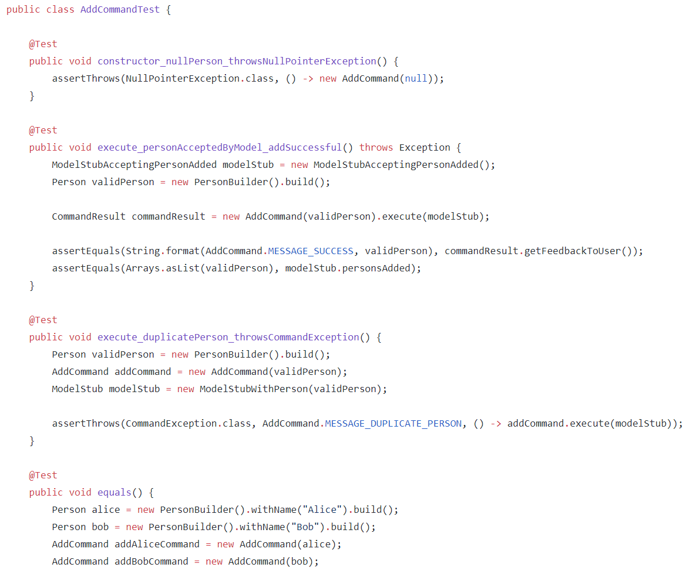
Pure unit testing: many test cases!
AddCommand
Model

Slide 13
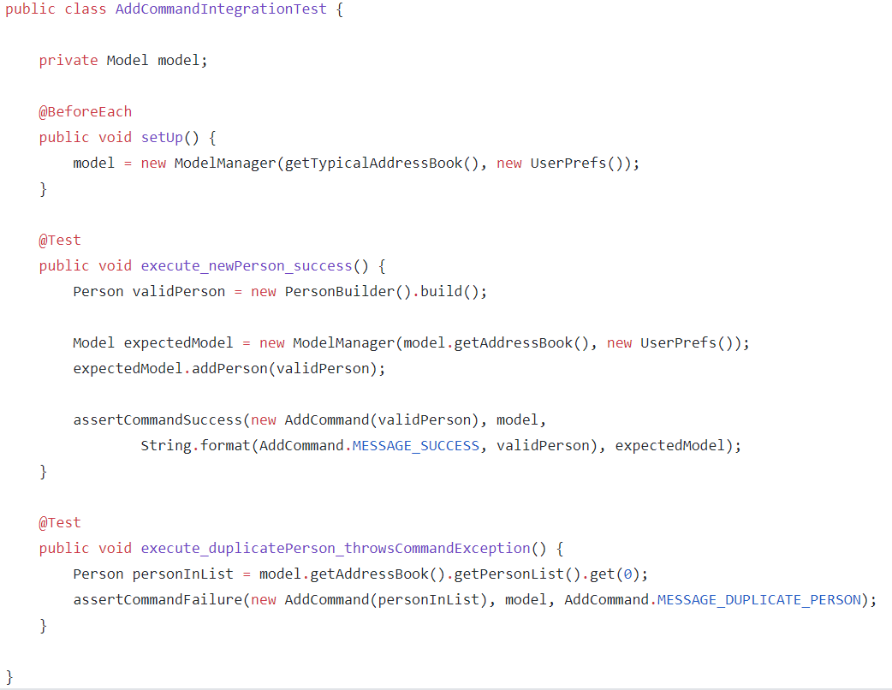
Pure integration testing: only 2 test cases!

Slide 14
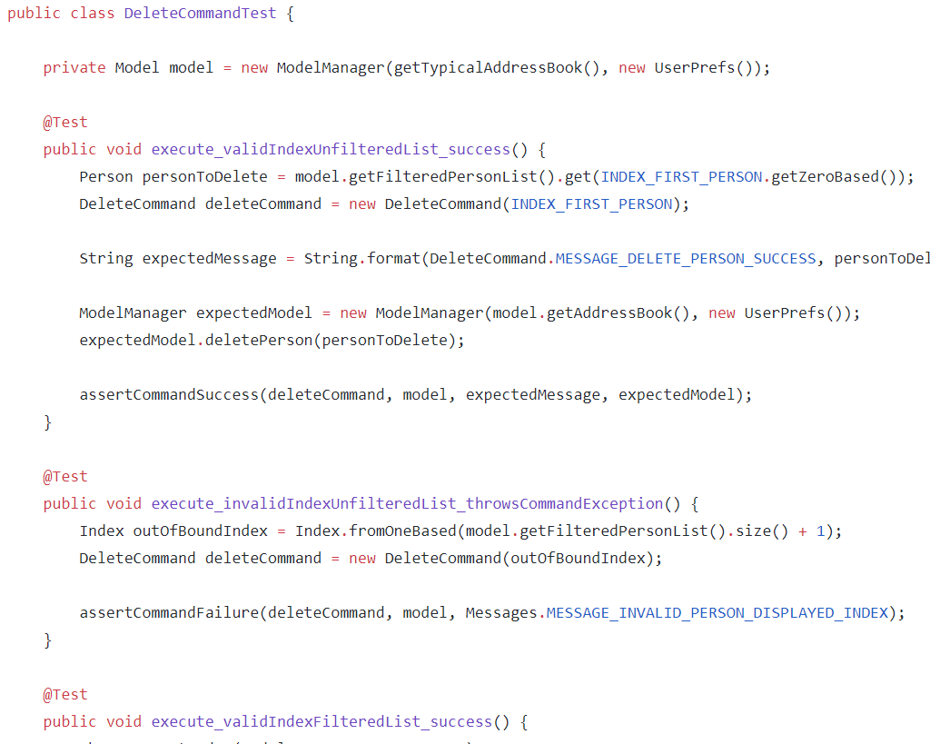
Hybrid: many tests cases because this is a unit + integration test

Slide 15
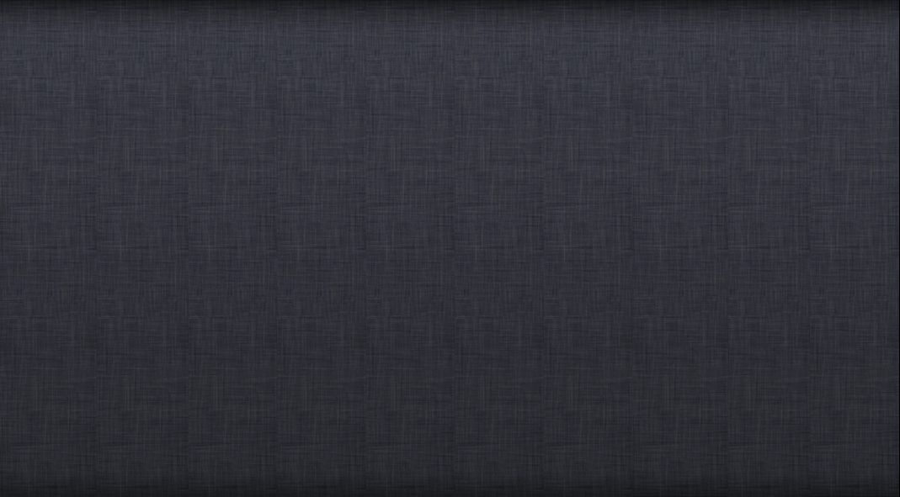


Acceptance testing
System testing

Slide 16
Acceptance testing
System testing
Product

Slide 17
Acceptance testing
System testing
I want to find an email from a given sender quickly.
Product
The system shall allow sorting by sender’s email address.
Requirements specification
System specification
Business Analysts
Designers
Engineers

Slide 18
Summary . . .
Unit testing
Integration testing
System testing
Acceptance testing

